Slide 1
Personal Protective Equipment Training
Created and Given by Aaron Deutsch

Slide 2
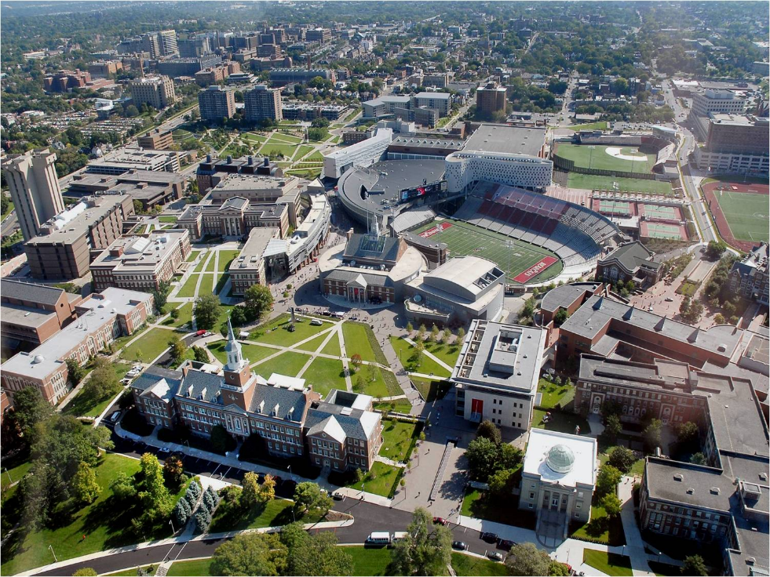
Level 1 Safety Brief
Hazards in the Room
What to do in the event of an emergency?
Meeting Locations

Slide 3
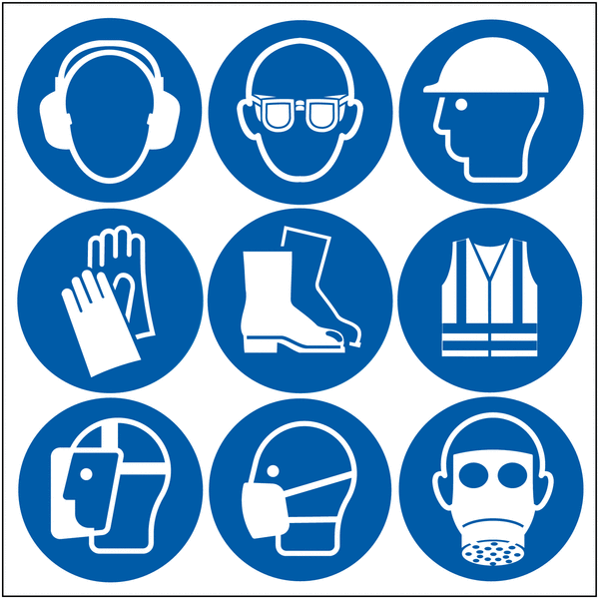
Types of PPE
There are many types of PPE all designed to keep you safe
Some examples are
  Safety glasses
  Safety goggles
  Face shields
  Cut resistant apparel
  Chemical resistant apparel
  Fire retardant apparel
  Hearing protection
  Foot protection
  Head protection
  Etc.

Slide 4
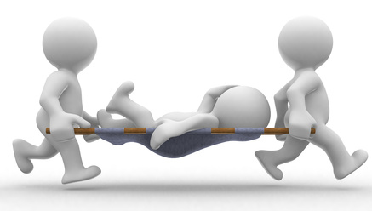
Why do we wear PPE
Anytime there is a potential risk of injury, that can be mitigated or avoided all together with PPE.
Always wear the proper PPE
Even though it may be uncomfortable, it is necessary that you do not modify or remove your PPE until you are out of harms way

Slide 5
When do we wear PPE
Gloves: When working with tools or working with sharp objects
Safety Glasses: When working around small particles or potential objects that can get in your eyes
Safety Goggles: When exposed to a hazard that can bypass safety glasses, i.e. chemicals
Face Shield: When working are small high velocity particles
Hearing Protection: Anytime when you are exposed to loud or repetitive noises
Chemical Resistant Apparel: When working with chemicals (read MSDS for proper PPE)

Slide 6
Are you safe with PPE
NO
Unless a hazard is completely eliminated, then you still are not safe. Even with the proper PPE there still is a risk of injury or death

Slide 7
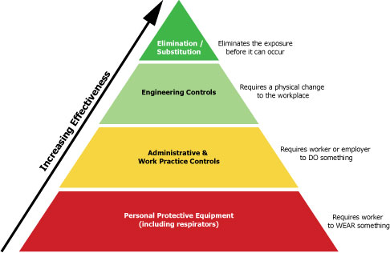
Fix it
If you find or are using faulty PPE
  Throw it away
  Replace it
  Fix it
Always STOP work if you do not have or have faulty PPE
You are not replaceable, but you PPE is. Always do the right thing

Slide 8

Questions?

